Slide 1


Binary Classification
Using Gradient-based optimization algorithms on binary Cross-Entropy loss function

Slide 2
Problem statement
Our main goal is to see if a customer subscribes to a term deposit or not in a bank.
We are going to model the probability of a person subscribing to the term deposit by several explanatory variables like age, job type, personal and home loan status etc. which are both numerical and categorical in nature.

Slide 3
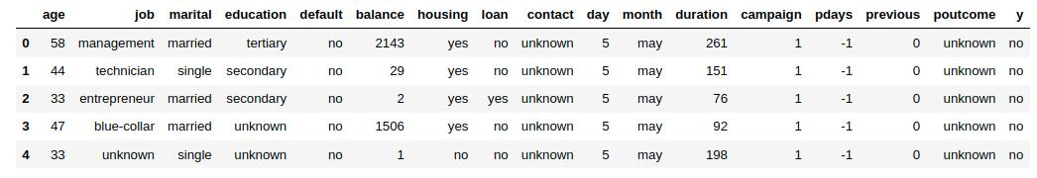
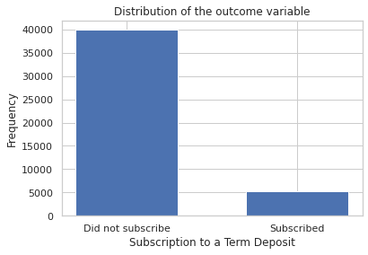
DATA
Source and snippet
SOURCE
https://www.kaggle.com/datasets/sonujha090/bank-marketing?select=bank-full.csv

Slide 4
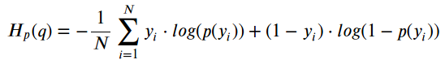
MODEL AND LOSS FUNCTION
We have 16 features and 45211 instances in our data. In the preprocessing phase we have discarded two features. We have chosen a simple Neural network (to avoid overfitting) consisting 4 Linear layers and ReLU as our activation function, since the data dimension is not huge.
We have chosen binary cross-entropy loss to go with. The formula of the loss function is given by,

Slide 5
WORKFLOW
Building Neural Network
Using vanilla Gradient Descent
Training our network using BCE Loss
Using SGD and its adaptive variants with different hyper parameters
Checking accuracy in each case and comparing
Using the variance-reduction variants

Slide 6
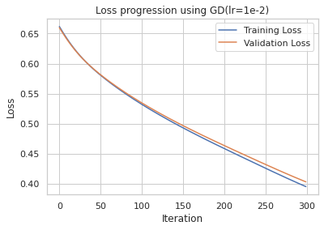
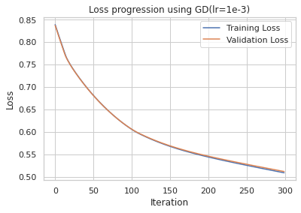
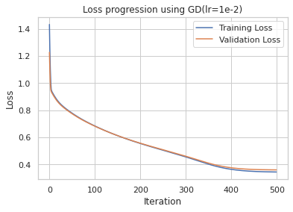
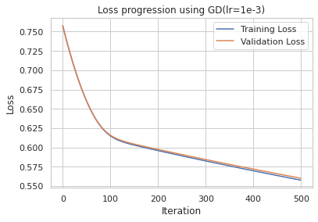
GRADIENT DESCENT
In Gradient descent we work with the whole batch of training sample. We propagate towards negative gradient calculated from the whole. When we used learning rate 1*10^-2 and 500 epochs, it seems the algorithm has reached the minima and achieves maximum accuracy, as opposed to the other cases it still shows a diminishing trend.
87.7027 %

Slide 7
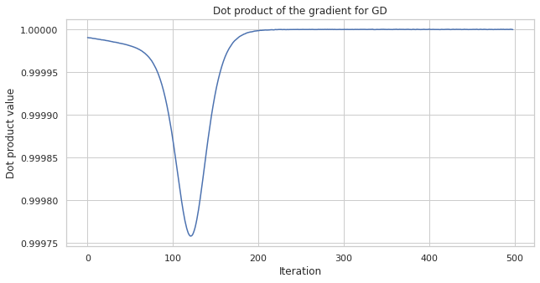
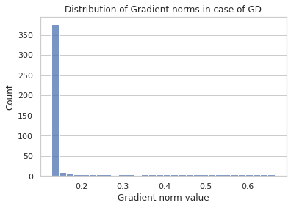
GRADIENT DESCENT (continued…)
Above, we show how the direction of the gradient corresponding to the last layer of the neural network changes with epochs. As expected the cosine value of the angle between gradients is very close to one or equal to one, that is the algorithm chooses perpendicular path in each epoch in the search space to find the minima.
The above histogram shows the distribution of the norm of the gradients in the last linear layer. It shows maximum density at zero and the curve diminishes or vanishes after zero.

Slide 8
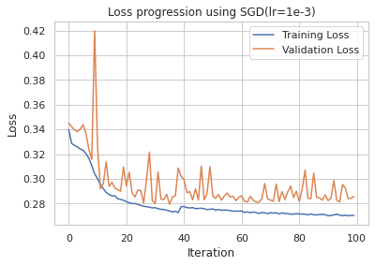
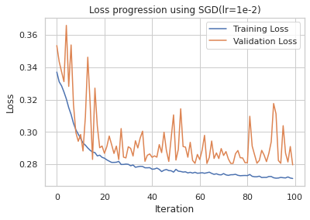
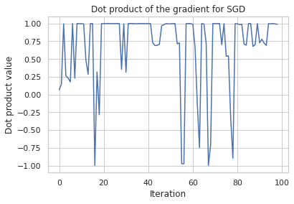
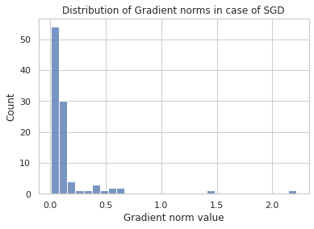
STOCHASTIC GRADIENT DESCENT
In SGD the gradient is calculated by selecting an observation from the training set randomly, so the the approximated gradient may be different from the actual gradient calculated using the whole training set. That is why the loss progression fluctuates continuously.
88.3663 %
As we can see for SGD the gradient direction in each epoch is not perpendicular to the previous and changing direction completely sometimes, also from the histogram it is clear that the estimated gradient is not unbiased estimator of the actual gradient.

Slide 9
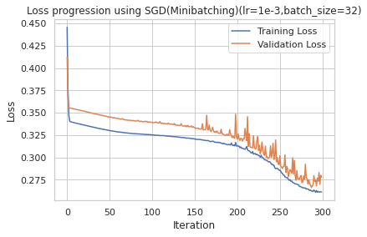
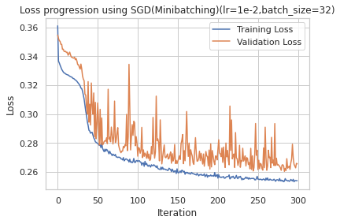
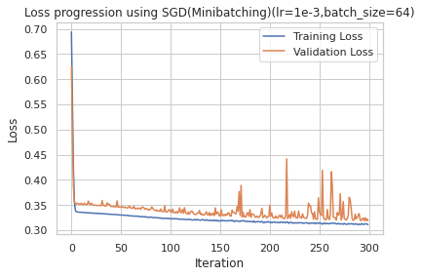
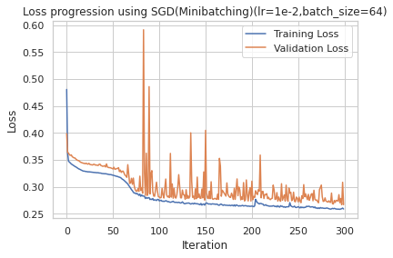
SGD WITH MINI-BATCHING
In SGD with mini-batching instead of an single observation, we take a batch of a random sample of fixed size to calculate the gradient. Statistically we know that a batch of sample gives us a better estimate of a parameter than a single observation. In the diagrams it is clear that if we increase the batch size, the loss progression is way more smoother. Also, both the batch sizes give us smoother loss progression than vanilla SGD
89.2657 %

Slide 10
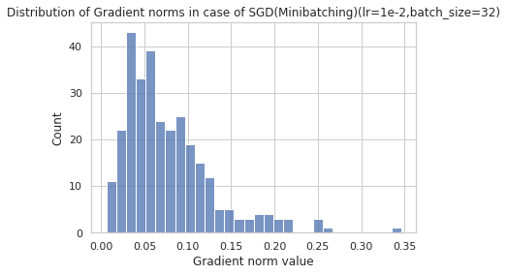
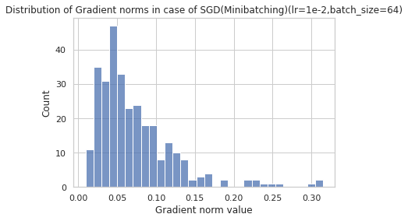
SGD WITH MINI-BATCHING (Continued…)
When we increase the sample size or batch size, it should estimate the actual true gradient in a better manner. From the histograms above, we can observe that the variance of estimated gradient has decreased, though neither of them gives us the unbiased estimate of the true gradient, because the distribution is multimodal and they neither show maximum concentration at zero nor show a steep diminish after zero.

Slide 11
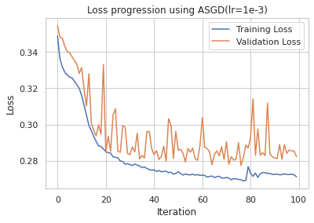
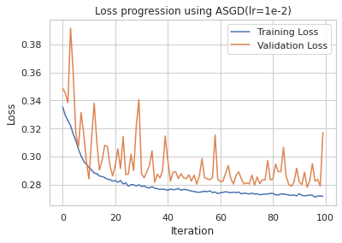
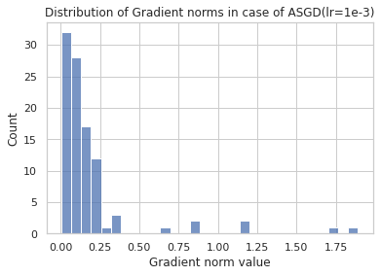
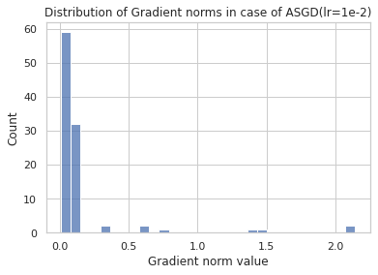
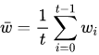
AVERAGE STOCHASTIC GRADIENT DESCENT (ASGD)
The averaging is used to reduce the effect of noise. Namely, in practice, your gradient descent may get close to the optimal, but not really converge to it, instead oscillating around the optimal. In this case, averaging the results of stochastic gradient descent will give you a solution more likely to be closer to the optimum.
The basic idea is to use the SGD update rule,
and take the output as the average output of SGD,
88.5285 %

Slide 12
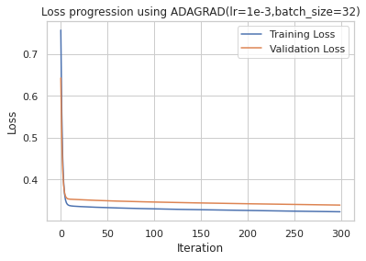
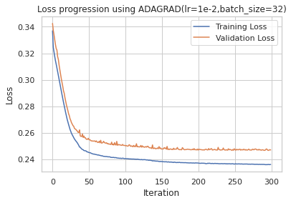
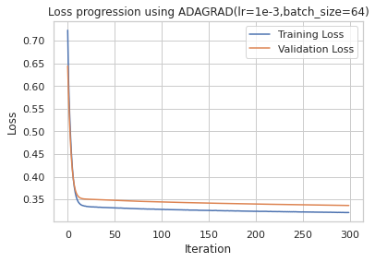
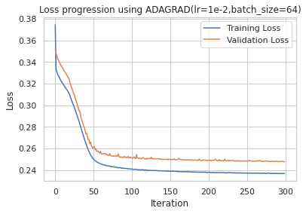
ADAPTIVE GRADIENT ALGORITHM (AdaGrad)
Adaptive Gradient Algorithm (Adagrad) is an algorithm for gradient-based optimization. The learning rate is adapted component-wise to the parameters by incorporating knowledge of past observations. It performs larger updates (e.g. high learning rates) for those parameters that are related to infrequent features and smaller updates (i.e. low learning rates) for frequent one. It performs smaller updates As a result, it is well-suited when dealing with sparse data (NLP or image recognition) Each parameter has its own learning rate that improves performance on problems with sparse gradients.
89.9292 %

Slide 13
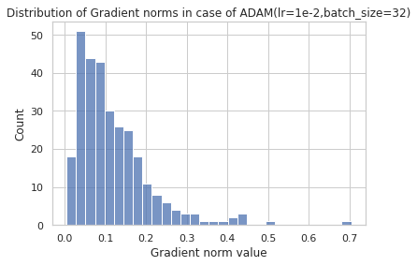
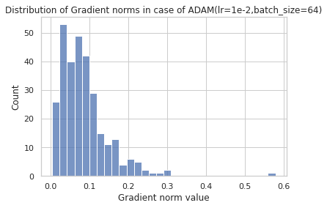
AdaGrad (Continued…)

Slide 14
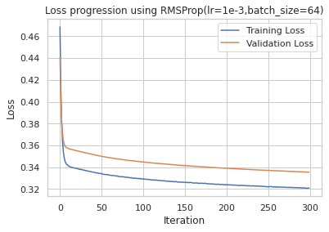
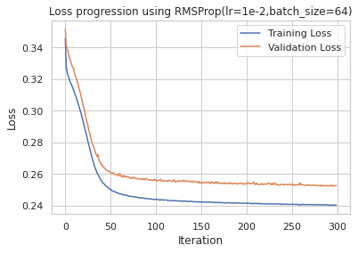
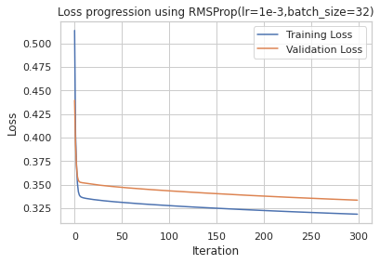
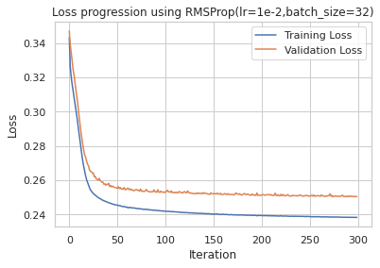
ROOT MEAN SQUARE PROPAGATION (RMSProp)
89.6491%

Slide 15
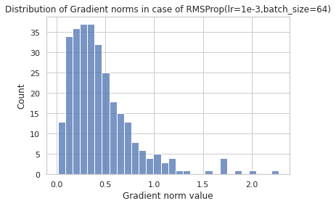
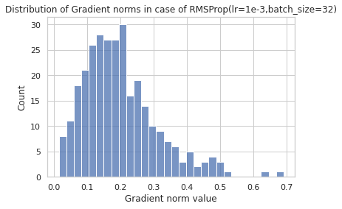
RMSProp (Continued…)

Slide 16
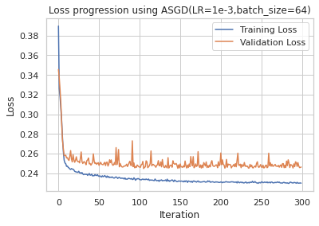
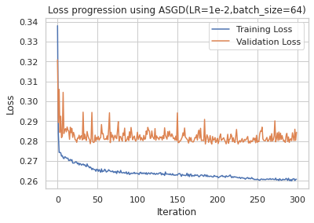
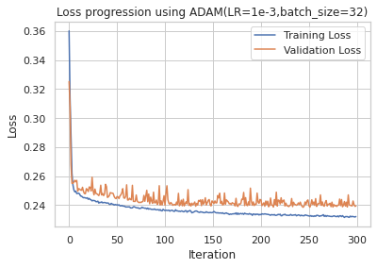
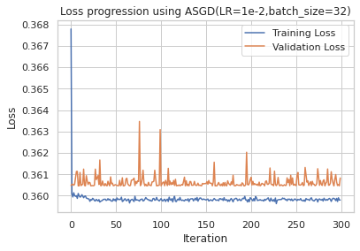
ADAPTIVE MOMENTUM ESTIMATION (ADAM)
89.7523%

Slide 17
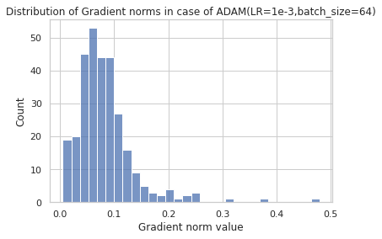
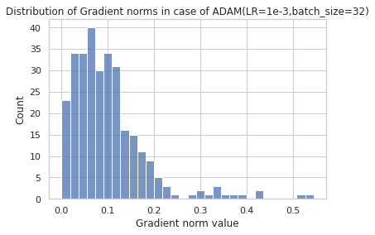
ADAM (Continued…)

Slide 18
RESULTS
89.9%
Highest Accuracy achieved
ALGORITHM - AdaGrad
HYPER-PARAMETERS—
Learning rate = 1e-2
Batch size = 64

